Slide 1
3 stages of film production
• preparation or pre-production
• shooting or production
• assembly or post-production

Slide 2
four key phases of activity for the film industry:
• production
• distribution
• publicity/marketing
• exhibition
(merchandising is also important)

Slide 3
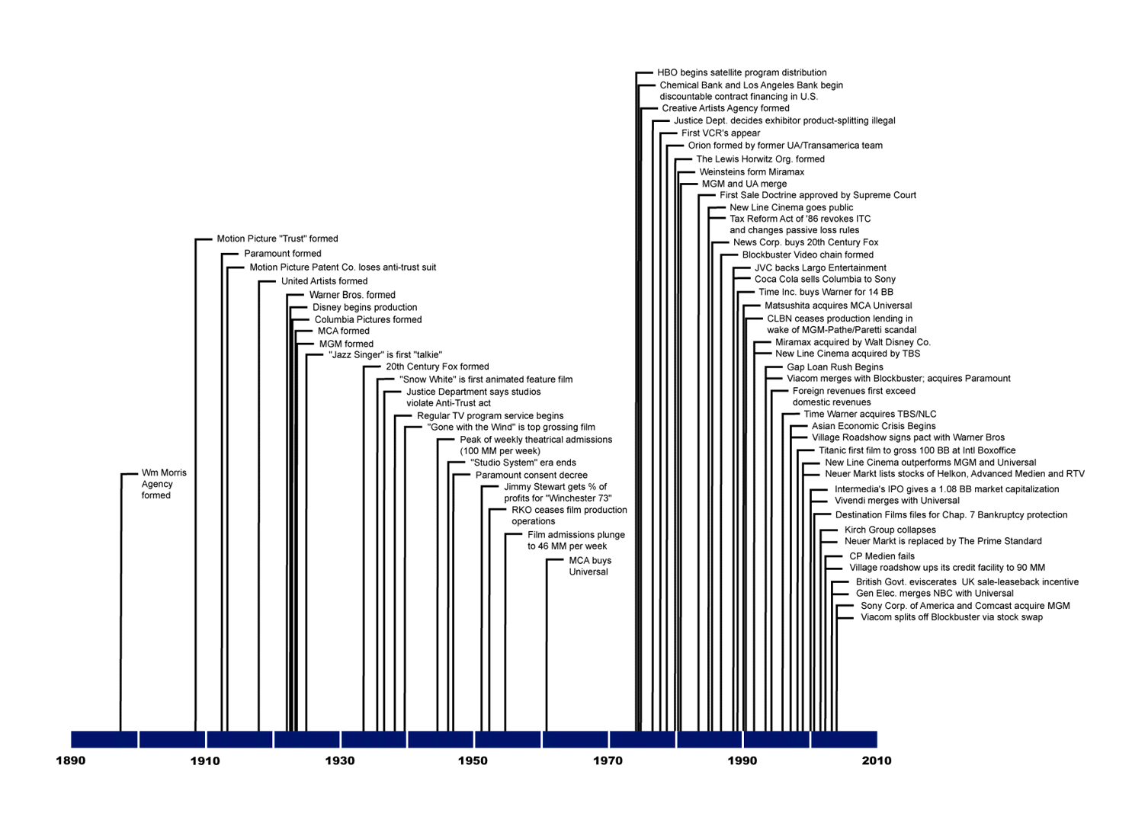

Slide 4
In these early years, the films were all silent and it was usual to have a live musical accompaniment. By the 1920s, grander cinemas might even have a full orchestra. Audiences could be quite noisy, often reading the ‘intertitles’ out loud.
Q. What kind of an experience do you think this might be?

Slide 5
Fully synchronised sound arrived in 1927-29.
By the 1930s half the population of Britain went to the cinema at least once a week.
Alongside the main film, audiences would also watch ‘B’ pictures and newsreels. Often there was also ‘live’ entertainment on the stage. The complete programme lasted about 4 hours.
By 1939 there were 5500 cinemas in Britain.
IN 1946, cinema attendance in Britain was the highest ever.

Slide 6
http://uk.youtube.com/watch?v=dtOD6PpDyXk&feature=related Lumiere
http://uk.youtube.com/watch?v=4nj0vEO4Q6s 100 clips
http://uk.youtube.com/watch?v=Kcv3FnLRXuU Nuremburg
http://uk.youtube.com/watch?v=g38miacSZKU corrie 1st (80’s reissue!)
http://uk.youtube.com/watch?v=zdB4UuYqwIg Oh Boy! 1959
http://uk.youtube.com/watch?v=AW-zR5LtaGs 1966 world cup

Slide 7
Why did cinema attendance decline dramatically in the 1950/60s?
Television
Post-war poverty.
There were only 15,000 television sets in Britain in 1945, but by 1955, when commercial television started, there were 5 million. By 1961 there were 11million sets and cinema admissions has fallen by 75%

Slide 8
entertainment tax went up; audiences couldn’t afford to go; prices went even higher
building materials, money and labour channelled into house-building. Very little left available for building/repairing cinemas.
Slum clearance and rebuilding programmes left many inner-city cinemas without a local audience
In 1947-1948, US film distributors boycotted Britain because the government proposed putting a high import duty on imported films. Robbed of Hollywood films, British cinemas had to fall back on old and poor quality films. Cinema audiences never recovered.

Slide 9
What happened in the 1980’s?
Video hire in the 1980s was a further blow to the cinema. At the lowest point, about 1985, there were less than 1000 cinemas open in Britain.

Slide 10
What began to improve the fortunes of cinema in the 1980’s?
  The rise of ‘multiplex’ cinemas. The first was opened in 1985
  out of town sites with easy access by car
  huge choice of films with 8,9 or even 12 different screens
Q. How does the modern cinema experience compare with the pre multiplex one?

Slide 11
Here are the statistics:
http://www.bfi.org.uk/filmtvinfo/stats/boxoffice/admissions.html
Also check out:
http://www.bfi.org.uk/features/ultimatefilm/cinemagoing.html
http://www.bfi.org.uk/filmtvinfo/stats/boxoffice.html
Check out a report on 2008 at the British Box Office:
http://www.ukfilmcouncil.org.uk/media/pdf/k/r/UK_box_office_report_2008_22_1_09.pdf
What will the effect of the recession be on cinema attendance?
http://www.thisismoney.co.uk/investing-and-markets/article.html?in_article_id=465272&in_page_id=3

Slide 12
You need to be aware of differences between the ‘Old Hollywood’ (The Studio System) and ‘New Hollywood’…..
The Studio System
· The golden age of the studio system was 1930-49.
· At this time. The big 5 were MGM, Paramount, Fox, Warners, RKO
· United Artists, Columbia and Universal were the other significant players but they did not own their own chains of cinemas as the ‘big 5’ did.
· Studios produced around 50 films a year
· Cast and crew were employed on long-term contracts and essentially each studio operated as an assembly line or film factory. There was less emphasis on the idea of film as ‘personal expression’; films were seen as money-making products.

Slide 13
• Directors worked on a number of films at a time and were often not involved in the editing (the final cut).
• Each studio was dominated to a greater or lesser extent by the ‘moguls’ who ran each studio
• Stars ‘belonged’ to studios and they were not free to work for another studio. http://www.filmreference.com/encyclopedia/Romantic-Comedy-Yugoslavia/Star-System-THE-STUDIO-SYSTEM-AND-STARS.html
Contrast this with the current star-dominated system!

Slide 14
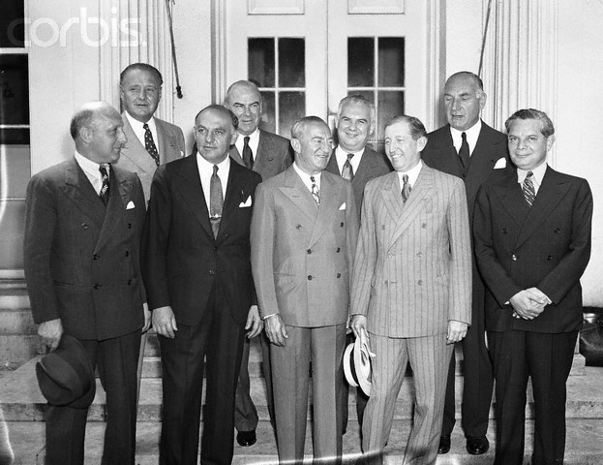
Howard Hughes and Hollywood Movie Moguls
leaving the White House 1938

Slide 15
• Each studio had its own ‘house style’ (a distinct look and feel)
• Some studios made use of a unit-producer system where a crew worked together under one producer to complete six to eight films a year (teams would sometimes specialise in a particular genre).
• Most significantly, the studios owned 2000 or so cinemas. These cinemas had the right to show Hollywood films before other cinemas. Studios therefore controlled the production, distribution and exhibition of their films.
➢ This is known as Vertical Integration – when a company owns all stages of the production, distribution and sole or, in the case of cinema, exhibition of its product.

Slide 16
• Together, the studios operated what is known as an Oligopoly: the control of a market for a particular product by a small group of companies in which no one company is dominant. They may well, however, work together a group to keep other companies out of the market.
• To maintain their control, they used the following methods:
Block booking –practice whereby major studios required cinema owners to buy up to a year of the studio’s films in advance.
Blind bidding –practice whereby cinema owners could not see the film before they bought it.
Run zone clearance system –practice whereby distribution of films was controlled by ‘zone’, with certain cinemas having the right to run the film first.

Slide 17
• All this came to an end with The Paramount Decree, 1948. This was a decision of the Supreme Court which ruled that the Studios had to sell their cinemas and lose their control of the distribution of films. This decision is widely thought to have marked the end of the Studio era.
• The studios went into decline, audience figures fell away and the emergence of television meant that many people predicted the end of cinema.

Slide 18
• The emergence of the blockbuster – ‘Jaws’ and ‘Star Wars’ in the 1970s gave the studios new life and opened up the possibility of making money from different sources, not simply box-office returns. Merchandising took off.
• Cinema audiences began to grow again from the mid-1980s (partly because of the emergence of the multiplex) and they are still growing today.

Slide 19
Has the power of the Studios really gone away??
Multinational Corporations or Conglomerates
As a result of mergers and takeovers media companies are increasingly coming together in conglomerates of media interests. A single multinational could have subsidiary companies:
• making, financing and distributing films;
• reviewing films in newspapers, or on TV/radio stations;
• publishing films scripts and distributing film soundtracks
• screening films via cinema chains or satellite TV

Slide 20
Here are some of the most obvious examples of these conglomerates:
• AOL-Time- Warner has interests in cable TV, film and television production and distribution, book and magazine publishing, the music industry and the internet. Owns Warner Brothers film studio, New Line Cinema and is one of he largest cinema owners in the world.
• News Corporation combines film and television production with distribution at Twentieth Century Fox, has invested in lower budget filmmaking at Fox Searchlight and runs Fox network television. Worldwide cable and satellite television interests incl ownership of BSkyB in Britain and Star TV in huge Asian market. Book publishing interests and controls a portfolio of newspapers that includes The Sun and The Times.
• Viacom-Paramount involved in film and television production and distribution, owns cable channels like MT, VH1 and Nickelodeon, controls television stations, has interests in book publishing and runs the Blockbuster video rental chain. In association with Vivendi, own a chain of cinemas worldwide.

Slide 21
These conglomerates benefit from Synergy – the way in which a single product, such as a film, can be used across a whole range of the company’s interests to generate profit. Here’s an example:
• Spider-man (Warner Bros)
Reviewed and advertised in the company’s magazines, e.g. Time, and television channels, like WB network.
Heavily promoted in the company’s own Warner Village cinemas globally.
Soundtrack on their Warner Bros label and the book of the making of the film through their own publishing company.
Becomes an attraction at the theme park in Germany.
Video and DVD of the film, along with other Spider-Man merchandise, would be on sale in the 50 Warner Bros shops…..a synergy is created across the transnational corporation.

Slide 22
• Some ‘spin-offs’ are relatively inexpensive and can generate huge profits. Developing a game is only likely to cost £3-4 million, a fraction of the cost of a mainstream Hollywood film. They can be real money-spinners…in 2001 in the UK, the games industry grossed more than cinema, video sales and video rental combines!

Slide 23
All this suggests that, although the oligopoly situation was broken in the 1950s, following the Paramount Decree in 1948, the industry giants seem to have re-established similar if not stronger control today.
The major difference is that now the income of these studios is no longer dependent upon immediate box-office takings.

Slide 24
How does a film get produced in the modern era?
• Essentially, an independent producer will bring a package to a studio and the studio will decide to ‘house’ or finance it. The major studios are not so involved in making their own films, but increasingly interested in financing independent productions and then controlling their distribution.
• Films are now made using a package-unit system where studio space is rented and personnel hired for the duration of the one project. Individual producers now have to put together a one-off package of finance, personnel, equipment and studio time for each film being made.

Slide 25
The Package
To generate the kind of confidence that secure investors, the producer of a film must put together a attractive proposal
• A script ‘treatment’ – information concerning storylines, characters and locations.
• The generic profile – what genre is it; how are genre elements developed in the film
• Proposed budget
• Visual representation of key scenes – ie storyboards for key narrative moments
• Key personnel – potential director, actors
• Potential spin-offs, merchandising and tie-ins

Slide 26
DISTRIBUTION
The distributor
acquires the rights to the film
• decides the number of prints to be made and released to exhibitors
• negotiates a release date for the prints
• arranges delivery of prints to cinemas
• provides trailers and publicity material for exhibitors
• puts together a package of advertising and publicity to promote the film
• negotiates related promotional and/or merchandising deals.

Slide 27
FILM DISTRIBUTION IS UNDERGOING SIGNIFICANT CHANGES AS A CONSEQUENCE OF THE DIGITAL REVOLUTION.
SEE Interesting talk by Peter Buckingham (Head of UK Film Council)
http://www.youtube.com/watch?v=zpNSkStMvyA

Slide 28
Typical Distribution Costs
• £80-£1000 for each print of the film made
• Up to £1000 to the British Board of Film Classification to certify the film.
• Production of cinema trailer.
• Print and advertising campaign
Any profit is dependent on the deals distributors can negotiate for DVD, video, cable, satellite and terrestrial television rights.

Slide 29
Total average cost, including marketing, for making a Hollywood movie has now gone beyond $100 million, for the first time, we can see that today distribution is as much, if not more, concerned with making profit from the selling of films to be shown on
video & DVD
subscription satellite and cable channels
terrestrial network television channels
syndicated television. Syndication is the selling of the rights to the hundreds of city- and state-wide television stations that exist across the USA.

Slide 30
Films go on generating money in many ways, long after their initial theatrical release. For example, the BBC is believed to have paid £7m to show Titanic on Christmas Day 2000.

Slide 31
MARKETING
• the total package of strategies used to try to promote and sell a film
• can be seen as three distinct areas – advertising, publicity and promotional deals worked out with other companies.
• focus groups to view and comment upon the film at various stages (test screenings).
• securing free publicity in the editorial sections of the media wherever possible
• devising eye-catching paid-for advertising
• obtaining tie-ins with other consumer products that will result in symbiotic promotional pay-offs for both products
• clinching merchandising deals that will create additional income but also further work to keep film product as a whole in the public eye

Slide 32

‘Jaws’ was one of the first productions to make use of TV advertising. Previously, TV had always been seen as the enemy. Universal spent over $700,000 on half-minute advertisements in prime time television shows.

Slide 33
Here’s some useful terminology for film marketing:
Word of mouth – other people telling you what a film is like and recommending it (or not!)
Marketability – the ease with which the film will generate interest because of its stars or its director.
Playability – the degree to which a film will continue to attract an audience because audiences like it and it gets good ‘word of mouth’
Festivals have a dual function – competitions + marketplace.

Slide 34
EXHIBITION
Exhibition – key questions
• In what countries is it to be shown?
• Should there be a single global release date?
• Should some countries receive the film before others?
• In which cinema chains is it to be shown in particular countries?
• Initially how many cinemas should it be released to in each country?
• How should this initial release be built upon in order to maximise the potential audience? How quickly is it to move on to DVD release?
• How long before it is shown on satellite, cable and terrestrial TV?

Slide 35
RELEASE PATTERNS
films have different release patterns:
General release right across the country
Select release to a few cinemas in a few cities where the audience is felt to be right for this particular film.
Saturation release to as many cinemas as possible.
Art-house release.
• The theatrical release is still the key commercial moment for any film in the sense that success or failure here determines the profitability of any deals that are going to be secured for the release of the product into other windows….but the key factor is that there is now an array of further marketing opportunities for any film over and beyond its cinema release.

Slide 36
AUDIENCES AS FANS & CONSUMERS
• Cinemas in the 1910-20s sometimes known as picture palaces. Recognized the need to give the public not only a choice of films but an appealing social experience.
Emphasis on a ‘total experience’ has perhaps re-emerged with ‘Multiplex’ cinemas.
• In the yr before opening of first multiplex in Milton Keynes in 1985 attendance was down to 52 million per year
In 1996 that was up to more than 123 million.
• 70% of screens and 90% of admissions are now in ‘out of town’ locations.

Slide 37
Audience figures
• By 1930, Americans were making 80 million visits a week to cinemas across the country (65% of the population going once a week!)
• Attendance dropped off a little in the economic depression of the 1930s.
• Attendance peaked immediately after the Second World War with 90 million visits a week in America and more than 30 million a week in Britain.
• Attendance has increased again over the past 10-15 years but the figures are now 27 million a week in the US and 3 million a week I Britain.
• Year 2000 was significant in Britain – cinema attendance returned to levels seen in 1974, the year when the long, steady dropping off of cinema attendance came to an end and went into a rapid decline.
New technologies & fandom
• Fans are much more able to interact and maintain an ongoing fan base for particular types of film product.

Slide 38
much academic debate about the role of ‘STARS’ in the production and reception of films.
a star can be thought of as having four distinct elements:
• the real person
• the characters/roles they play
• the persona – a combination of the first two
• the image that then circulates in secondary media
In the Studio era, stars were contracted to a studio for seven years.
It is now common practice for stars to have a percentage of the box office takings of a film.
Also, a star’s contract may stipulate that they should be involved in any decisions relating to script, director, cast, publicity, schedule, nudity and even the Final Cut
In publicity interviews, questions need to be submitted in advance and certainly lines of questioning will be specifically forbidden.
One argument is that the only ‘power’ stars have is the power to make money both for themselves and for other people.

Slide 39
THE BRITISH CINEMA INDUSTRY
What is a British Film? – No easy answer.
• a predominantly British cast and crew?
• British funding?
• Discussions of issues whicha re pertinent to British audiences in particular?
• A British target audience?
• Representations of Britain and the British way of life?

Slide 40
How are British films financed?
• Most British films are collaborations between several sources of film financing. They can include government support through the Film Council, a distributor, a broadcaster such as the BBC and an equity investor ( putting in money and recovering their investment when the film is released plus a share of the profits).

Slide 41
What’s wrong with the British Film Industry?
• The British market has traditionally been production led. Distribution is almost invariably through an American company, and in order to complete the film the producer may have agreed a disadvantageous pre-sale of the distribution rights meaning that any money made is not likely to be reinvested in British production, being instead diverted overseas.
• This is in clear contrast to the American model where the film industry has diversified to strengthen and develop links with other media and other delivery platforms, and in doing so have created vast media empires, conglomerated that maximise the profit from a single film through owning and controlling the rights to every element in it. Thus even a weak film will eventually come into profit without damaging the parent company.
• Lottery funding of British films has been criticised. Rather than allocating funds to particular films, lottery money was distributed widely, to may small projects. Money for script development was given to projects that either did not make it to the big screen, or when they got into cinemas the films were criticised for their poor quality and made little return at the box office.

Slide 42
The British Film Industry – What crisis?
In terms of the rest of the world, the British film industry is in good shape and is seen as one of the most dynamic in the world.
Global market for film = $63bn in 2002
80% American share
5% British share (25% of the non-American share)
Britain is the third largest film market against revenue (after America and Japan).
• British Gov has tried to encourage growth of the film industry, in particular through Section 42 tax break which makes Britain a very attractive place in which to shoot a film.
• The Film Council believe that the use of digital technology should be encouraged as a means of reducing costs while maintaining quality.
• Digital film-makers have been able to use the internet as a means of distributing and exhibiting their work (websites such as Britshorts; Ifilm; atomfilms.
• Nightmare scenario for big studios is that broadband technology allows films to be pirated across the net…..they are trying to release films simultaneously in as many territories as possible, making pirated films less attractive.

